Slide 1
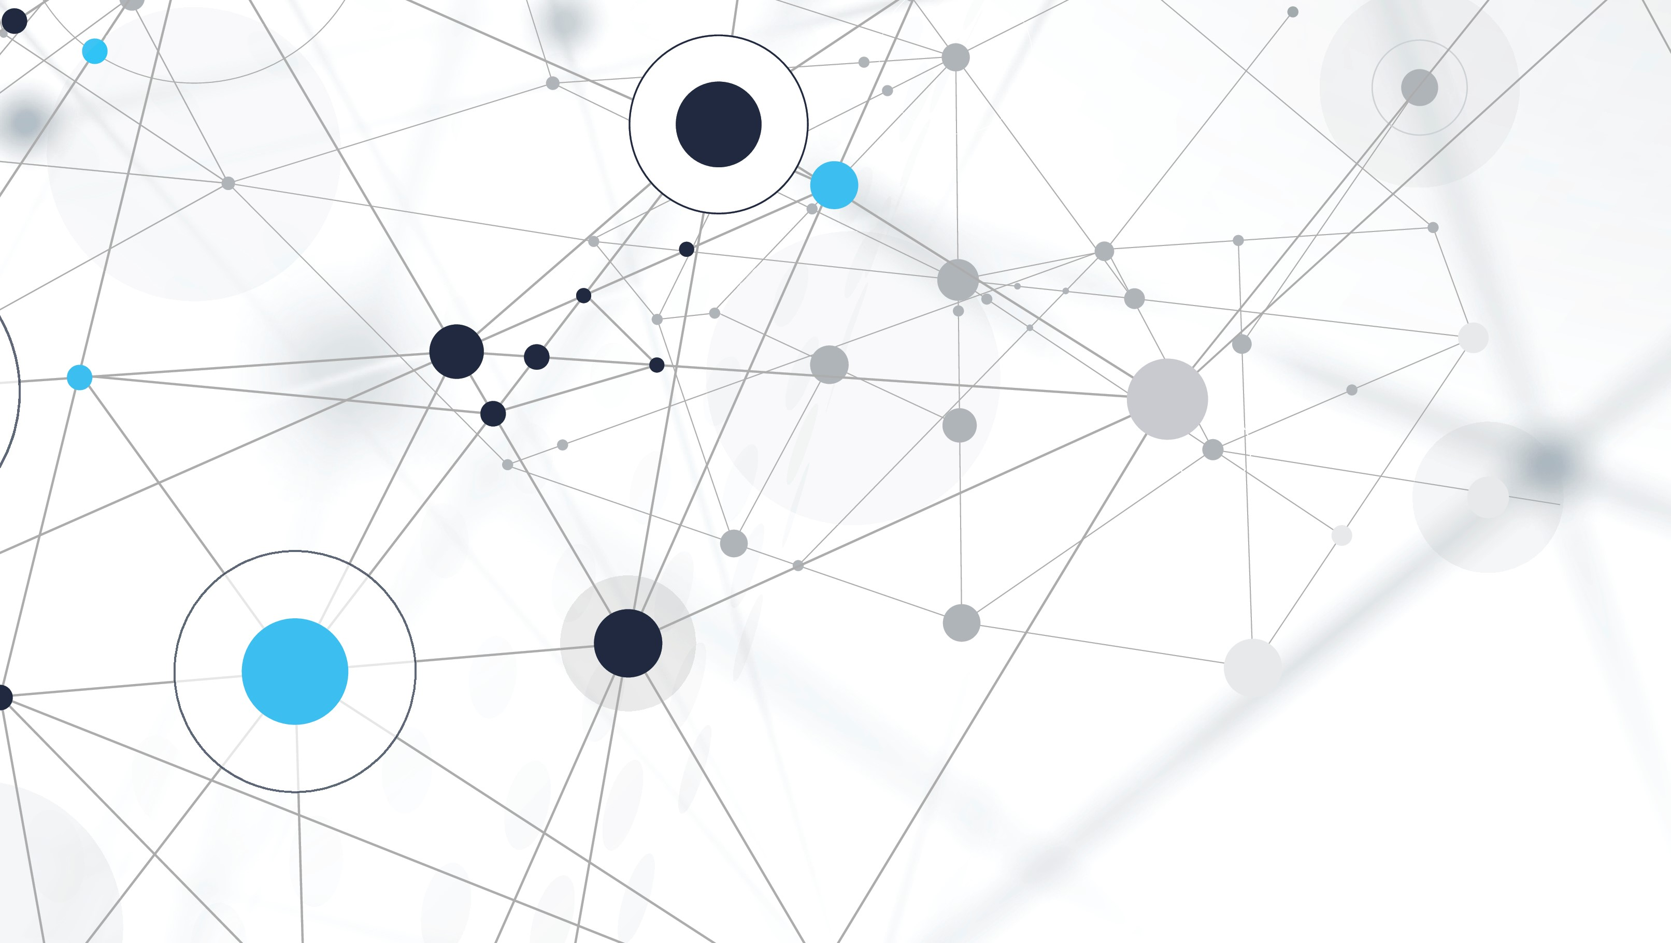
Brain tumor DeTECTION using svm
MALAVIKA DILU – 21ECB0F23
ABHINAV KONDA – 21ECB0F27

Slide 2
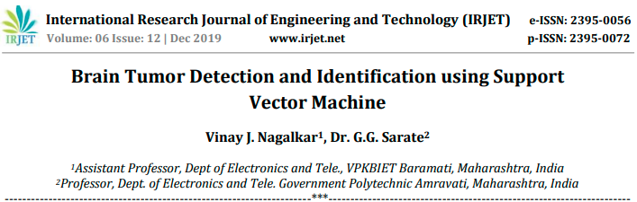
RESEARCH PAPER
IRJET-V6I12349.pdf

Slide 3
BRAIN TUMOR DETECTION USING SVM
In this project we have tried to detect the presence of pituitary tumor using MRI scans for various patients using SVM.
LIBRARIES USED
Numpy
Pandas
Matplotlib
Sklearn
Os
Cv
DATA SET
179-Testing (105-no tumor, 74- pituitary tumor)
1222-Training(395-no tumor,827-pituitary tumor)

Slide 4
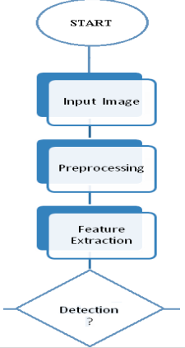
FLOWCHART
Abnormal Normal

Slide 5
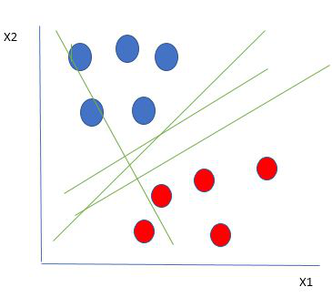
SVM
Support Vector Machine(SVM) is a supervised machine learning algorithm used for both classification and regression. Though we say regression problems as well its best suited for classification. The objective of SVM algorithm is to find a hyperplane in an N-dimensional space that distinctly classifies the data points. The dimension of the hyperplane depends upon the number of features. If the number of input features is two, then the hyperplane is just a line. If the number of input features is three, then the hyperplane becomes a 2-D plane. It becomes difficult to imagine when the number of features exceeds three.
Let’s consider two independent variables x1, x2 and one dependent variable which is either a blue circle or a red circle.

Slide 6
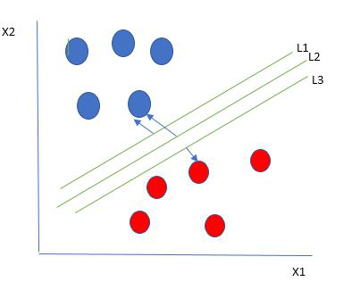
From the figure above its very clear that there are multiple lines (our hyperplane here is a line because we are considering only two input features x1, x2) that segregates our data points or does a classification between red and blue circles..
Selecting the best hyper-plane:
One reasonable choice as the best hyperplane is the one that represents the largest separation or margin between the two classes.

Slide 7
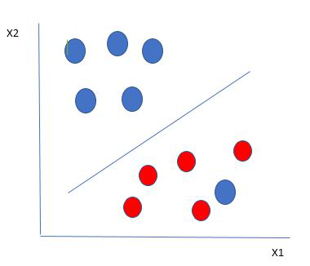
So we choose the hyperplane whose distance from it to the nearest data point on each side is maximized. If such a hyperplane exists it is known as the maximum-margin hyperplane/hard margin. So from the above figure, we choose L2.
Here we have one blue ball in the boundary of the red ball. The blue ball in the boundary of red ones is an outlier of blue balls. The SVM algorithm has the characteristics to ignore the outlier and finds the best hyperplane that maximizes the margin. SVM is robust to outliers.

Slide 8
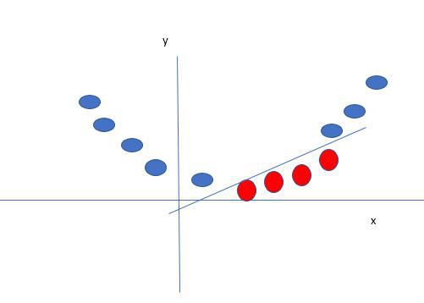
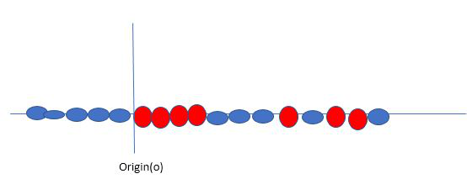
SVM Kernel:
The SVM kernel is a function that takes low dimensional input space and transforms it into higher-dimensional space, ie it converts non separable problem to separable problem. It is mostly useful in non-linear separation problems. Simply put the kernel, it does some extremely complex data transformations then finds out the process to separate the data based on the labels or outputs defined.
SVM Kernel:
The SVM kernel is a function that takes low dimensional input space and transforms it into higher-dimensional space, ie it converts non separable problem to separable problem. It is mostly useful in non-linear separation problems. Simply put the kernel, it does some extremely complex data transformations then finds out the process to separate the data based on the labels or outputs defined.

Slide 9
ADVANTAGES OF SVM
Effective in high dimensional cases
Its memory efficient as it uses a subset of training points in the decision function called support vectors
Different kernel functions can be specified for the decision functions and its possible to specify custom kernels

Slide 10
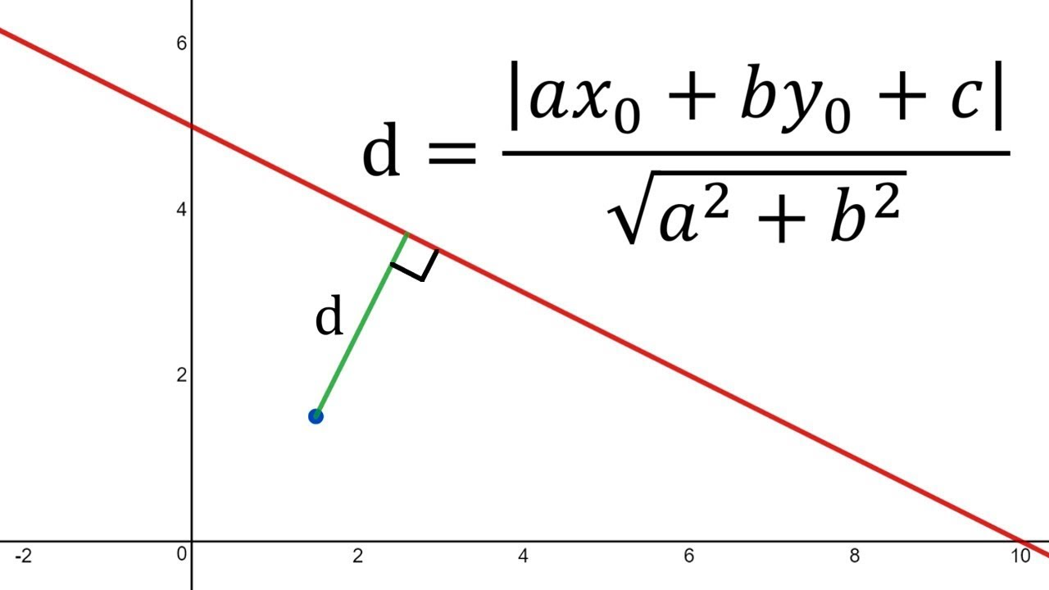
MATHEMATICS OF SVM
The hyperplane equation dividing the points (for classifying) can now easily be written as:
H: w^{T}(x) + b = 0
Here: b = Intercept and bias term of the hyperplane equation
While fitting the separating line, we would obviously want such a line that would be able to segregate the data points in the best possible way having the least mistakes/errors of miss-classification. So, to have the least errors in the classification of the data points, that concept will require us to first know the distance between a data point and the separating line.

Slide 11



the distance of a hyperplane equation: w^{T}Φ(x) + b = 0 from a given point vector Φ(x₀) can be easily written as :
here ||w||2 is the Euclidean norm for the length of w given by :
The goal is to maximize the minimum distance.”

Slide 12
WHY SVM AND NOT ANN
In a support vector machine, using the kernel-trick, you "send" the data into a higher dimensional space where it can be linearly separable. In a neural network you perform a series of linear combinations mixed with (usually) non linear activation functions across several layers.
In other words, ANN minimizes only the empirical risk learnt from the training samples, but SVM considers both this risk and the structural risk. Consequently, the training results from SVM have better generalization capability than those from ANN.

Slide 13
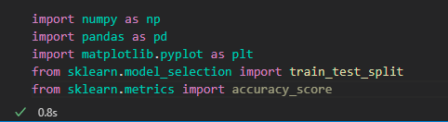

CODE

Slide 14
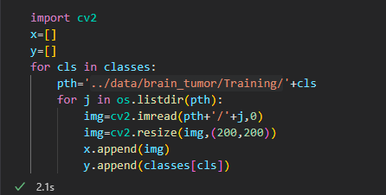





Slide 15
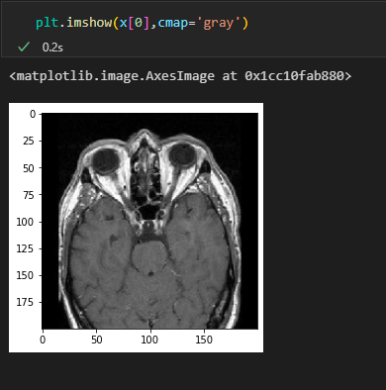
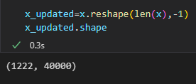

Slide 16
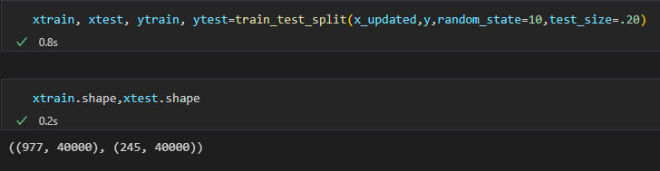
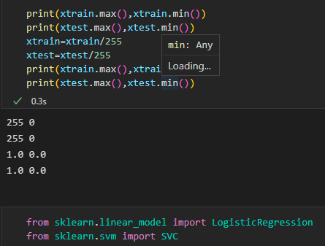

Slide 17
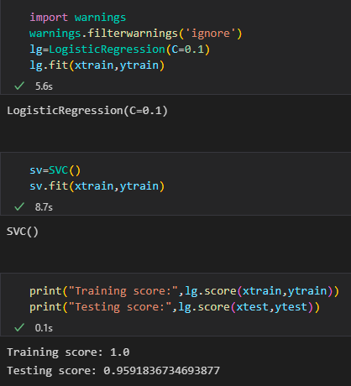
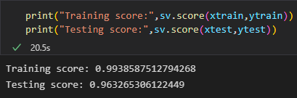

Slide 18
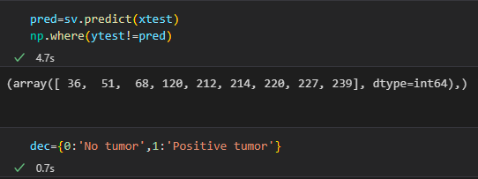
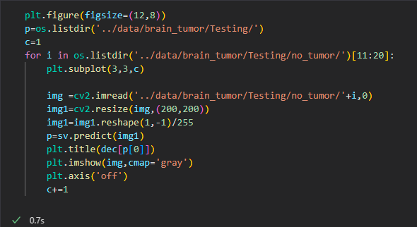

Slide 19
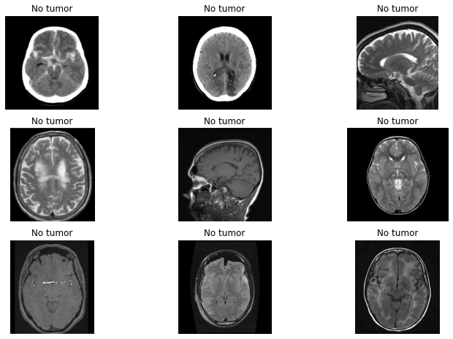

Slide 20
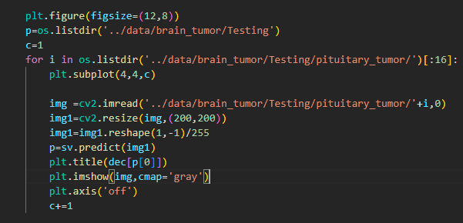
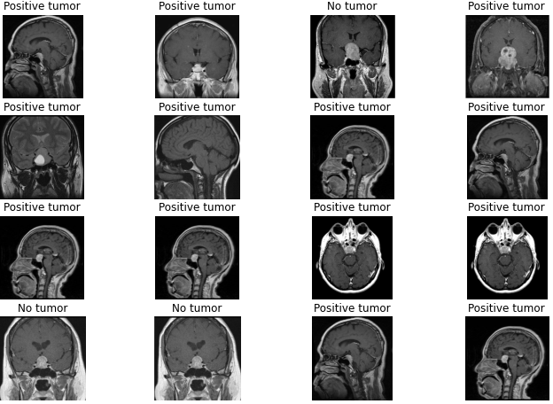

Slide 21
CONCLUSION
Using SVM we have obtained an accuracy of 99% in training and 96% in testing.
This project can be further extended to classify different types of tumors.

